Slide 1
201812
Tungsten Tip Etching
Lee Jong Geon

Slide 2
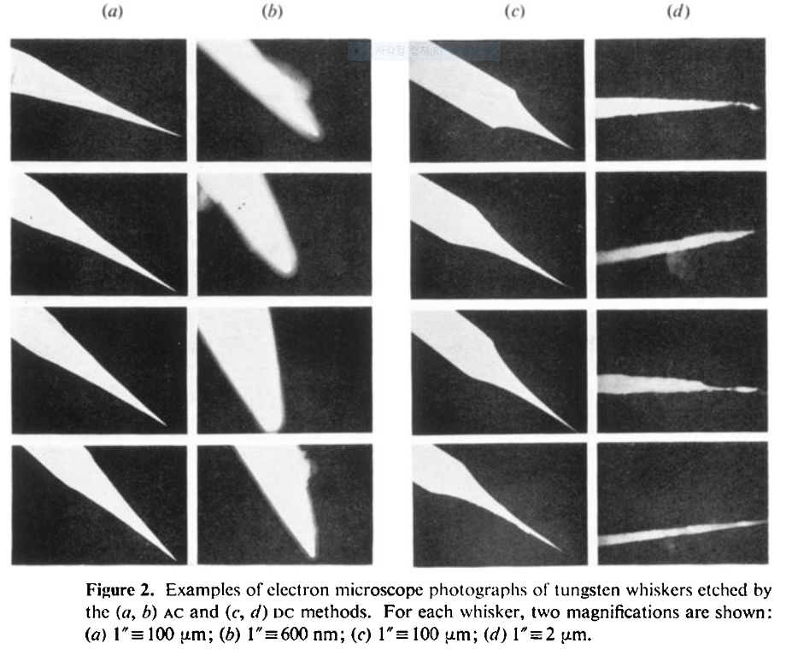
1978-J. Phys. D: Appl. Phys.-11-A comparison of AC and DC electrochemical etching techniques for the fabrication of tungsten whiskers (G. J. Edwards and P. R. Pearce)
AC
DC

Slide 3
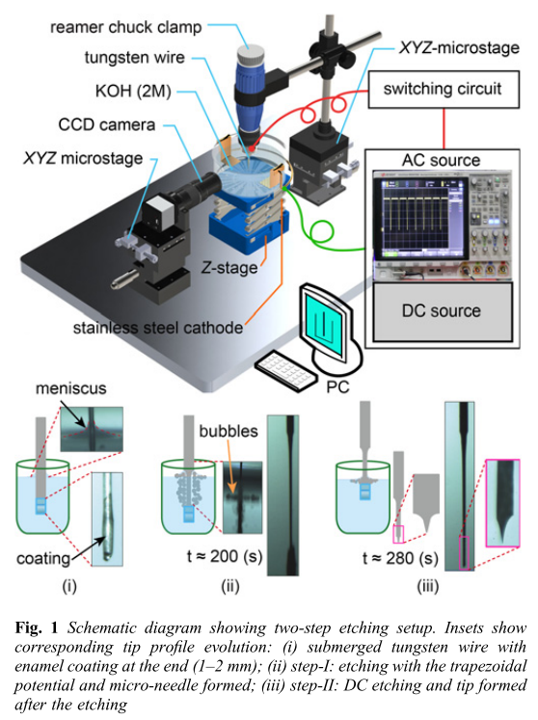
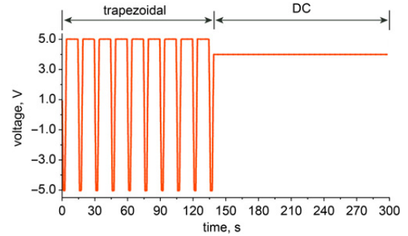
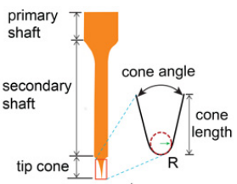
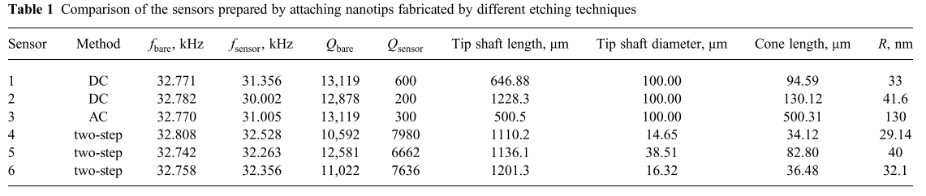
2018-Micro&Nano Letters-13,8-Electrochemical etching of lightweight nanotips for high quality-factor quartz tuning fork force sensor: atomic force microscopy applications (Danish Hussain, Jianmin Song, Hao Zhang, Xianghe meng and Hui Xie)
Two step
primary shaft diameter and length in the range of 10–40 μm and 2–5 mm, respectively, can be fabricated with high success rate (∼80%).
High Q-factor

Slide 4
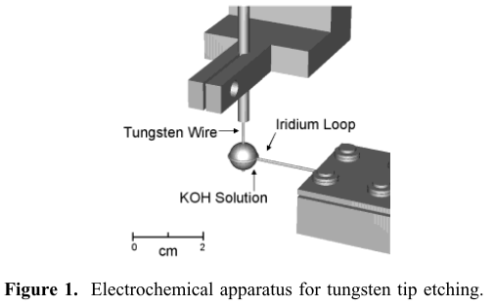
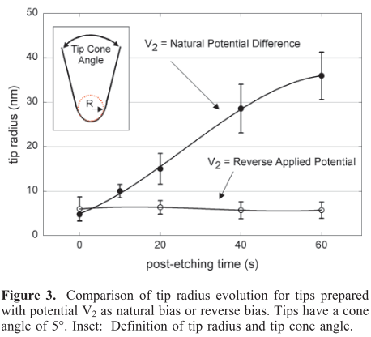
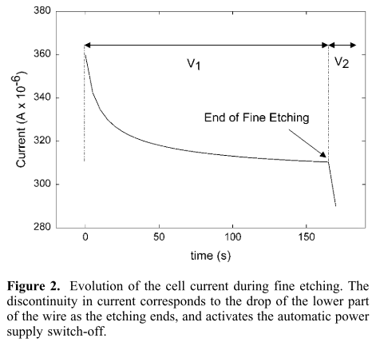
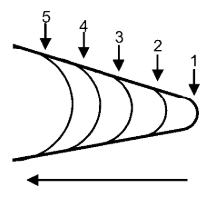
2002-Nano Letters-2,3-Reproducible Electrochemical Etching of Tungsten Probe Tips (Olivier L. Guise, Joachim W. Ahner, Moon-Chul Jung, Peter C. Goughnour, and John T. Yates, Jr.)
Post-etching: wire가 끊어진 이후에도 etching process를 진행하는 것
Each data point corresponds to an average of at least 5 tips.
This method produces tips in a very controlled and reproducible manner.

Slide 5
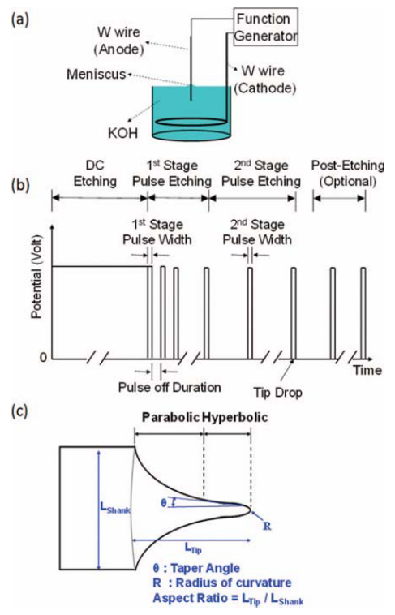
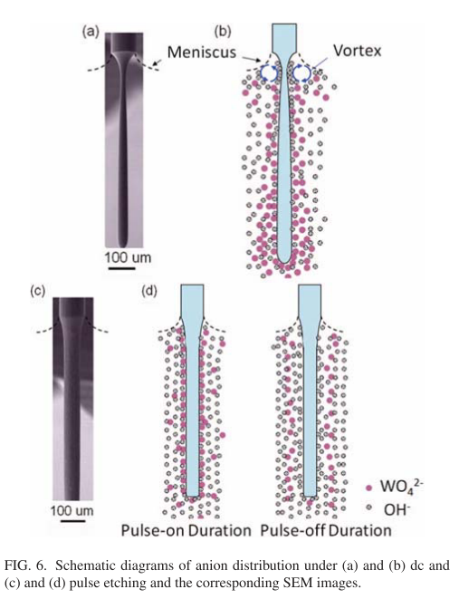
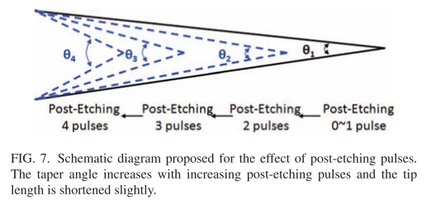
2012-Rev. Sci. Instrum.-83,08374-Method of electrochemical etching of tungsten tips with controllable profiles(Wei-Tse Chang, Ing-Shouh Hwang, Mu-Tung Chang, Chung-Yueh Lin, Wei-Hao Hsu and Jin-Long Hou)
AFG-3051, GW Instek, Taiwan
10M KOH – reduce time, meniscus stable
DC(uniform)
etching
Pulse
etching

Slide 6
2017-Microelectronic Engineering-173-Progrmmable set-up for electrochemical preparation of STM tips and ultra-sharp field emission cathods(Alexandr Knapek, jiri Sykora, Jana Chlumska, Dinara Sobola)

